Slide 1



UNIT 6; Lend me your ear
Lesson 5; Wanna know this!

Slide 2
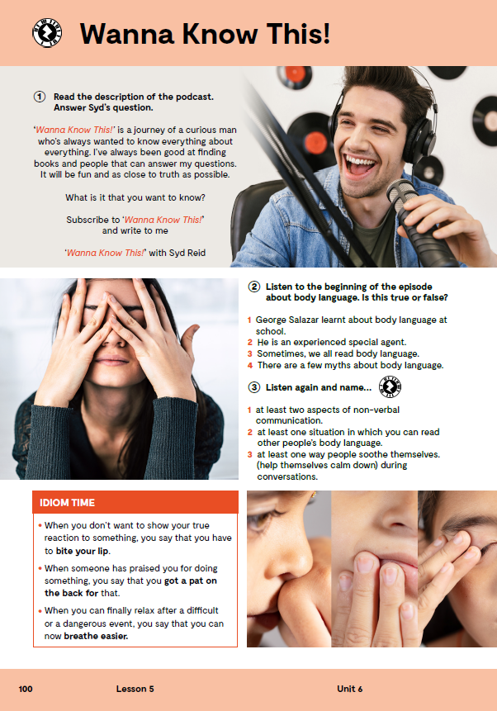
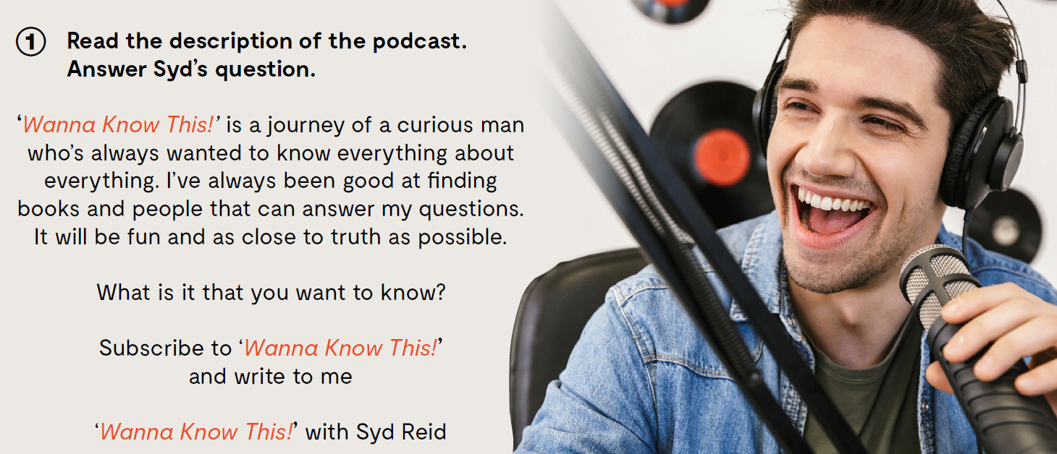

Slide 3

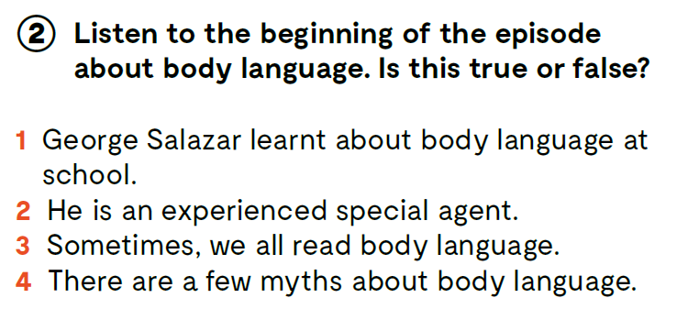

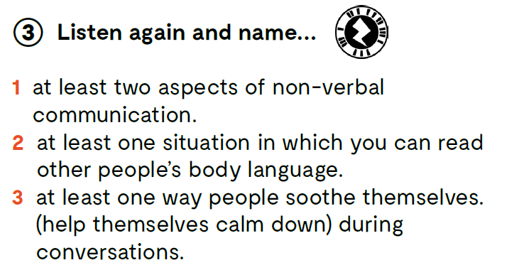
https://www.e-sfera.hr/dodatni-digitalni-sadrzaji/b26dd917-70c6-4352-992a-124f5f390314/assets/audio/25_unit_6__lesson_5__exercise_2_3.mp3
F
T
T
F
https://www.e-sfera.hr/dodatni-digitalni-sadrzaji/b26dd917-70c6-4352-992a-124f5f390314/assets/audio/25_unit_6__lesson_5__exercise_2_3.mp3

Slide 4

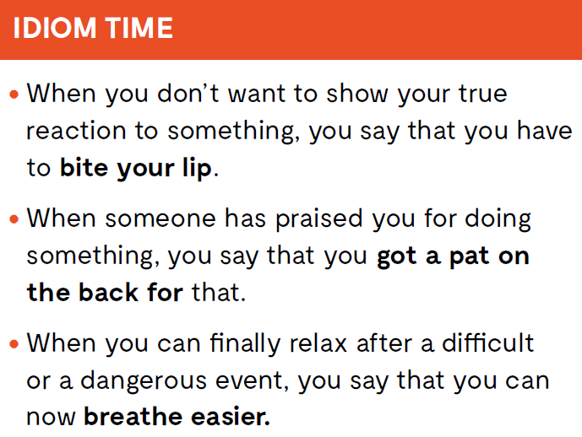

Slide 5
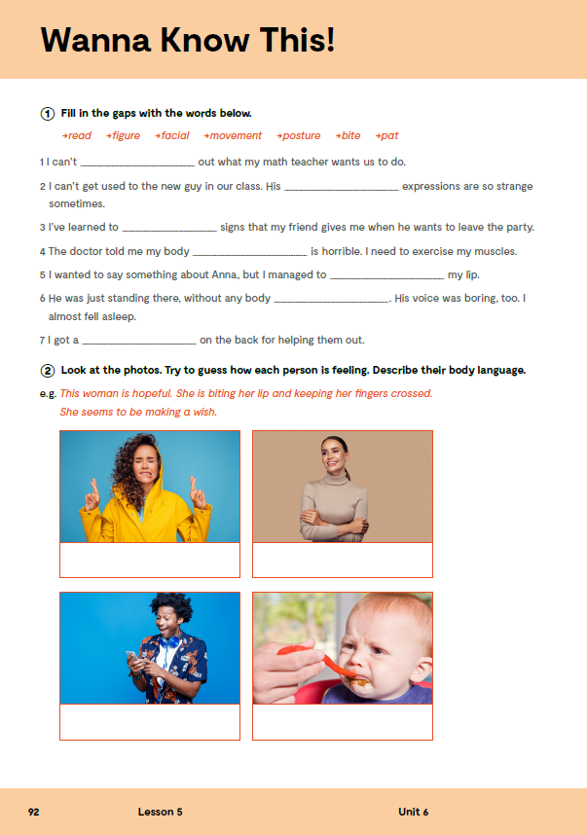
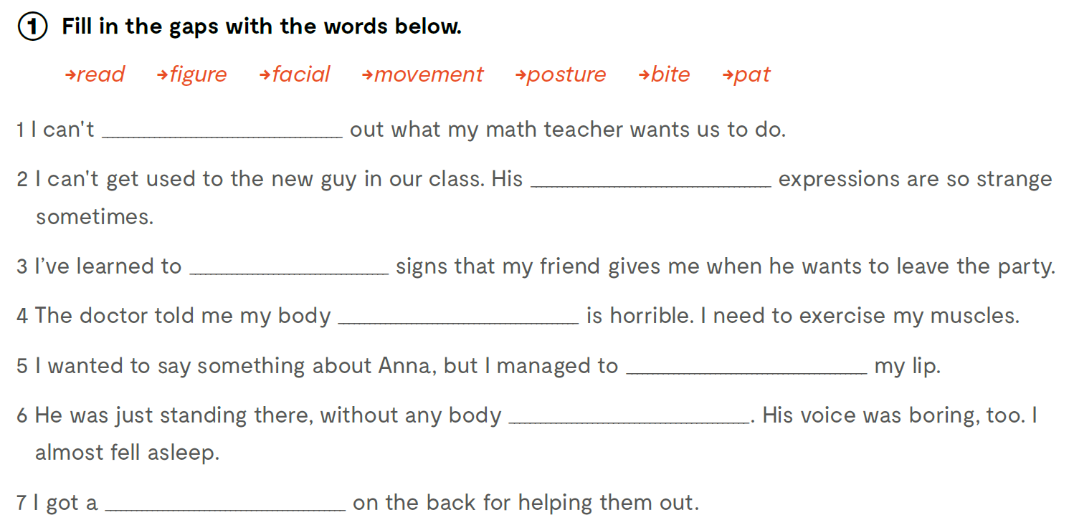
Workbook, page 92.
.
figure
facial
read
posture
bite
movement
pat

Slide 6
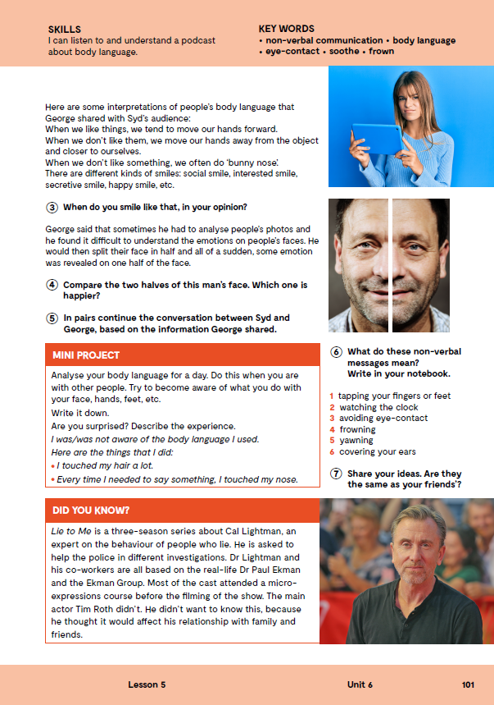

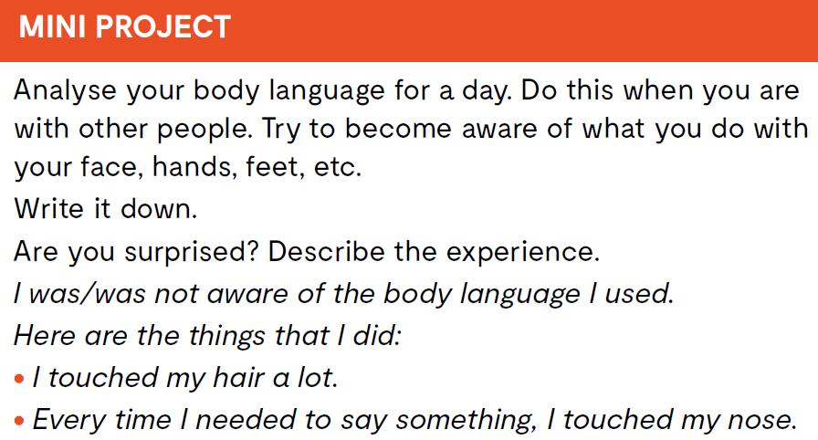
Open the following link and then click on LEARN MORE! https://www.e-sfera.hr/dodatni-digitalni-sadrzaji/b26dd917-70c6-4352-992a-124f5f390314/
The Art of Podcasting
Read the texts and do the tasks bellow the text. Pročitaj tekstove i riješi zadatke ispod teksta.

Slide 7

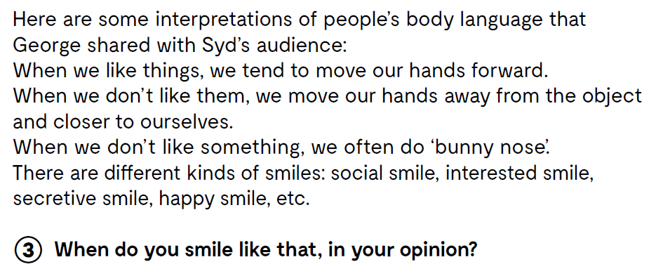

Slide 8
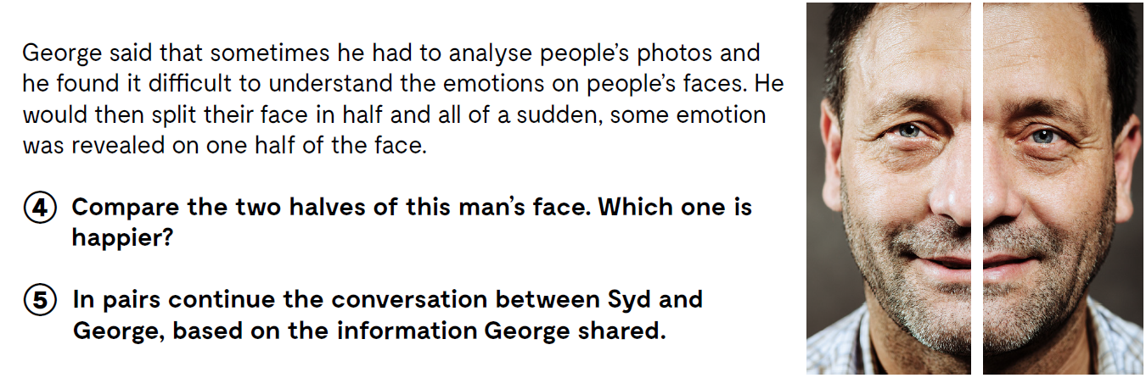

Slide 9
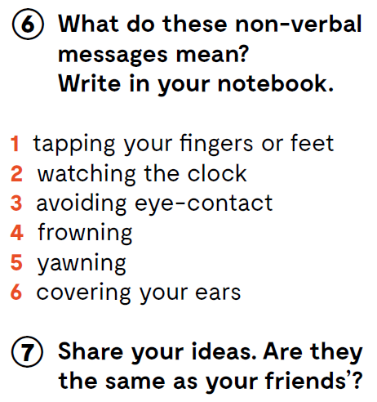

Slide 10

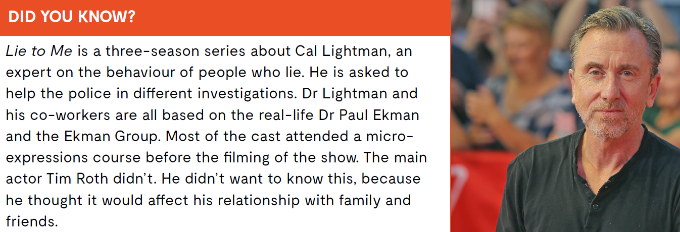

Slide 11
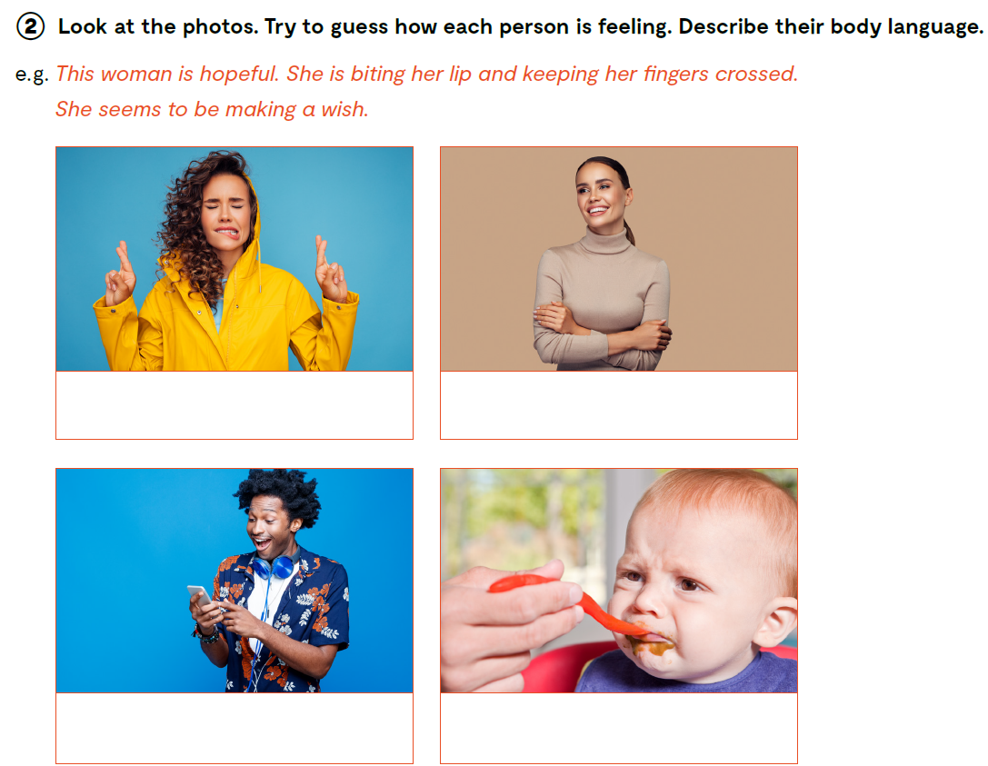
Workbook, page 92.

Slide 12
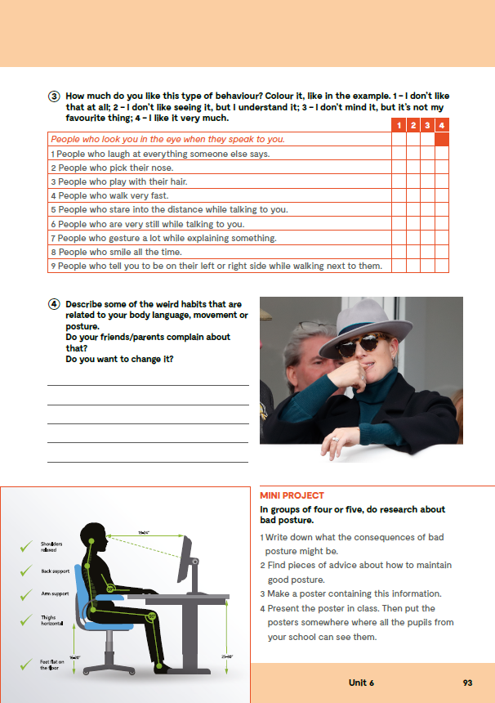
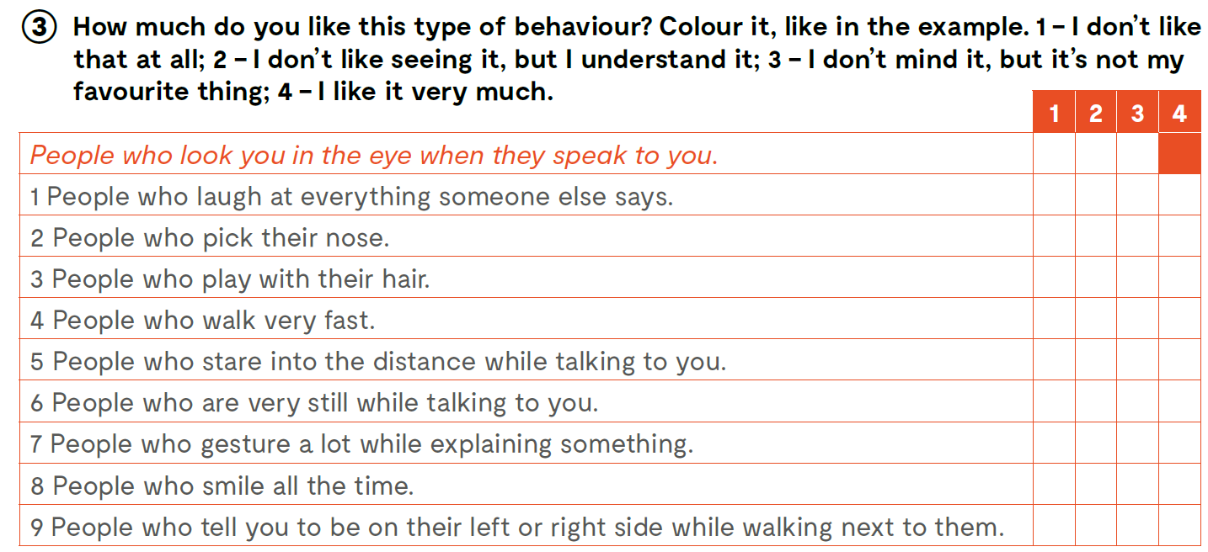

Slide 13
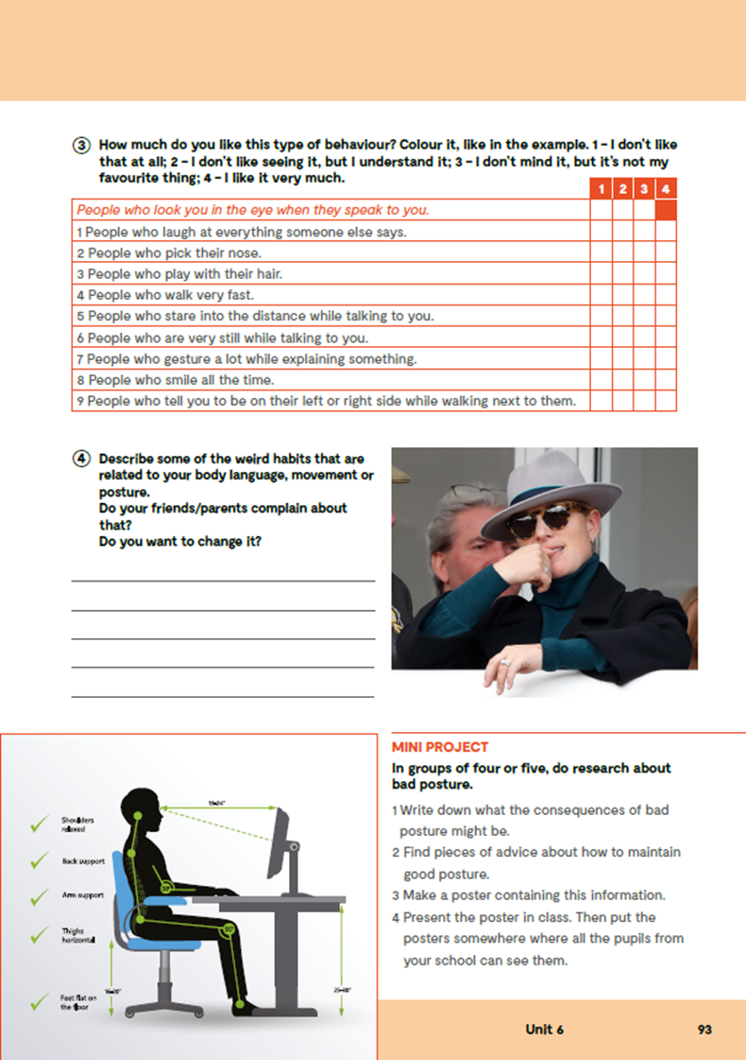
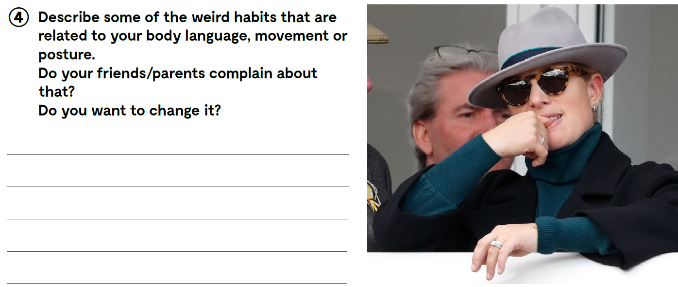
Check what you have learnt. https://www.bookwidgets.com/play/WCBBYW7

Slide 14
